Slide 1
Python Day 2 Arithmetic Operations
By Rachael Sera

Slide 2
Review: Data Types

Slide 3
Data types
Data is stored as particular types

Slide 4
Data Types
int (integers – whole numbers)
float (decimal numbers)
string (characters wrapped in quotation marks)

Slide 5
Data types
What data types are each of the variables below?
length = 5
result = 5+3
radius = 2.5
animal = “cat”
answer = result
size = “5”

Slide 6
Review: Variables

Slide 7
Variables
Variable name always goes on the left of the =
Value to store in the variable goes on the right of the =
The name is the label where that value is stored

Slide 8
Review: print() and input()

Slide 9
Print()
print(“The answer is”, ans)
“Arguments” go inside parentheses; separate arguments with a comma
There are two arguments in the above example; one string and one variable

Slide 10
Input() with Strings
name = input(“Please enter your name”)
Always store the return value in a variable
Add a message to the user inside quotes inside the parentheses

Slide 11
Input() with non-strings
length = int(input(“Please enter the length”))
Always store the return value in a variable
Add a message to the user inside quotes inside the parentheses
“Cast” the return value for data types other than strings

Slide 12
Arithmetic Operations

Slide 13
Arithmetic Operators
+
Addition
-
Subtraction
*
Multiplication
/
Division

Slide 14
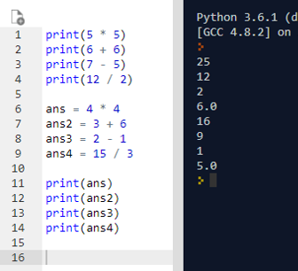
Arithmetic Operations
Print to see result
Directly in print()
Or store in a variable and then print the variable

Slide 15
Example 1: Calculating Area
Write a program to calculate the area of a rectangle
Notes:
Solve on paper first. Solve with just printing area, then printing pretty message to user, then using user input for values.

Slide 16
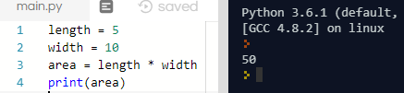
Area of a rectangle

Slide 17
Solving Equations
You can solve equations for other variables:
area = length * width
length = area / width

Slide 18
Example 2: Tax Calculator
Write a program that calculates the total cost of an item with tax, given the item’s cost and the current tax rate.
Notes:
Solve on paper first.

Slide 19

Tax Calculator

Slide 20
Arithmetic Operations: Advanced

Slide 21
More Arithmetic Operators
**
Exponentiation
//
Integer division
%
Modulus (mod)

Slide 22
Exponentiation
2 ** 0 = 1
2 ** 1 = 2
2 ** 2 = 4
2 ** 4 = 16
a ** b raises a to the power of b
2 ** 3 = 8

Slide 23
Integer Division
Integer division is the whole number result of the division, just leave off the remainder
4 // 2 = 2
10 // 2 = 5
3 // 2 = 1
7 // 2 = 3

Slide 24
Integer Division
Integer division is the whole number result of the division, just leave off the remainder
5 // 1 = 5
5 // 2 = 2
5 // 3 = 1
5 // 4 = 1
5 // 5 = 1
5 // 6 = 0

Slide 25
Modulus (mod)
5 % 1 = 0
5 % 2 = 1
5 % 3 = 2
5 % 4 = 1
5 % 5 = 0
5 % 6 = 5
The modulus is the remainder after you perform division

Slide 26
Modulus (mod)
4 % 2 = 0
10 % 2 = 0
3 % 2 = 1
7 % 2 = 1
7 % 5 = 2
The modulus is the remainder after you perform division

Slide 27
Example 3: Cupcakes
You are buying cupcakes for friends. You want to split the cupcakes evenly among the friends.
No one wants to eat half a cupcake, so the number of cupcakes per person should be a whole number.
Write a program to determine how many cupcakes each person gets, and how many are left over.
Notes:
Solve on paper first.

Slide 28
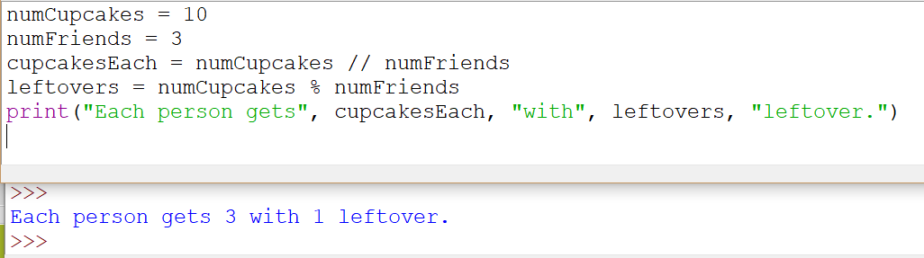
Example 3: Cupcakes

Slide 29
Materials
http://www.eecs.ucf.edu/JuniorKnights/material/
Book for additional reading
These slides are
github.com/rsera/junior-knights
Meeting dates
The problems for today are
Python Day 2 Arithmetic Operations.pptx
1 Arithmetic Exercises.docx
http://bit.ly/2PJNKCz

